Slide 1
Cellular Simulations
Modified from: Muneesh Tewari

Slide 2
Learning Objectives
To learn about approaches for modeling simple and complex systems
To learn about agent-based modeling

Slide 3
Complex systems
What makes a system Simple vs. Complicated vs. Complex?

Slide 4
Complex systems
Insights From Complexity Science (eg, Non-Linear Dynamics)
• Simple systems
Few components, mostly linear interactions
Outcomes are achieved in predictable ways

Slide 5
Complex systems
Insights From Complexity Science (eg, Non-Linear Dynamics)
• Simple systems
Few components, mostly linear interactions
Outcomes are achieved in predictable ways
• Complicated systems
Many components, still mostly linear interactions
Outcomes achieved in (mostly) predictable ways

Slide 6
Complex systems
Insights From Complexity Science (eg, Non-Linear Dynamics)
• Simple systems
Few components, mostly linear interactions
Outcomes are achieved in predictable ways
• Complicated systems
Many components, still mostly linear interactions
Outcomes achieved in (mostly) predictable ways
• Complex systems
Many components, non-linear interactions
Outcomes are not precisely predictable

Slide 7

Complex systems
Insights From Complexity Science (eg, Non-Linear Dynamics)
• Simple systems
Few components, mostly linear interactions
Outcomes are achieved in predictable ways
• Complicated systems
Many components, still mostly linear interactions
Outcomes achieved in (mostly) predictable ways
• Complex systems
Many components, non-linear interactions
Outcomes are not precisely predictable
(Baking a) Cake

Slide 8

Complex systems
Insights From Complexity Science (eg, Non-Linear Dynamics)
• Simple systems
Few components, mostly linear interactions
Outcomes are achieved in predictable ways
• Complicated systems
Many components, still mostly linear interactions
Outcomes achieved in (mostly) predictable ways
• Complex systems
Many components, non-linear interactions
Outcomes are not precisely predictable
(Baking a) Cake
747 Airliner

Slide 9

Complex systems
Insights From Complexity Science (eg, Non-Linear Dynamics)
• Simple systems
Few components, mostly linear interactions
Outcomes are achieved in predictable ways
• Complicated systems
Many components, still mostly linear interactions
Outcomes achieved in (mostly) predictable ways
• Complex systems
Many components, non-linear interactions
Outcomes are not precisely predictable
(Baking a) Cake
747 Airliner
Raising a Child

Slide 10
Complex systems
Insights From Complexity Science (eg, Non-Linear Dynamics)
• Simple systems
Few components, mostly linear interactions
Outcomes are achieved in predictable ways
• Complicated systems
Many components, still mostly linear interactions
Outcomes achieved in (mostly) predictable ways
• Complex systems
Many components, non-linear interactions
Outcomes are not precisely predictable
Predicting Protein Sequence from DNA

Slide 11
Complex systems
Insights From Complexity Science (eg, Non-Linear Dynamics)
• Simple systems
Few components, mostly linear interactions
Outcomes are achieved in predictable ways
• Complicated systems
Many components, still mostly linear interactions
Outcomes achieved in (mostly) predictable ways
• Complex systems
Many components, non-linear interactions
Outcomes are not precisely predictable
Predicting Protein Sequence from DNA
Constructing Phylogenetic Trees

Slide 12
Complex systems
Insights From Complexity Science (eg, Non-Linear Dynamics)
• Simple systems
Few components, mostly linear interactions
Outcomes are achieved in predictable ways
• Complicated systems
Many components, still mostly linear interactions
Outcomes achieved in (mostly) predictable ways
• Complex systems
Many components, non-linear interactions
Outcomes are not precisely predictable
Predicting Protein Sequence from DNA
Constructing Phylogenetic Trees
Building a Computational Model for a Cell

Slide 13
Some Approaches for Analyzing Systems
Simple/Complicated Systems
- Differential Equations-based models
- ex: bacterial DNA damage response
- Clustering, Correlation analysis, etc.
Complex Systems
- sometimes, Simple systems can be embedded in Complex ones
→ “islands of linearity”
- sometimes, simple rules can lead to complex behaviors
- complex systems modeling uses alternative modeling tools
→ ex: agent-based modeling

Slide 14
Some Approaches for Analyzing Systems
Simple/Complicated Systems
- Differential Equations-based models
- ex: bacterial DNA damage response
- Clustering, Correlation analysis, etc.
Complex Systems
- sometimes, Simple systems can be embedded in Complex ones
→ “islands of linearity”
- sometimes, simple rules can lead to complex behaviors
- complex systems modeling uses alternative modeling tools
→ ex: agent-based modeling

Slide 15
How can we simulate a cellular system?
100’s of completed genomes
1000’s of known reactions
10,000’s of known 3D structures
100,000’s of protein-ligand interactions
1,000,000’s of known proteins & enzymes
Decades of biological/chemical know-how
Computational & Mathematical resources
Need different approaches for complex system

Slide 16
Agent-Based Modeling: Cellular Automata
Computer modelling method that uses lattices and discrete state “rules” to model time dependent processes – a way to animate things
No differential equations to solve, easy to calculate, more phenomenological
Simple unit behavior -> complex group behavior
Used to model fluid flow, percolation, reaction + diffusion, traffic flow, pheromone tracking, predator-prey models, ecology, social nets
David Wishart
University of Alberta
Toronto, Dec. 6, 2004

Slide 17
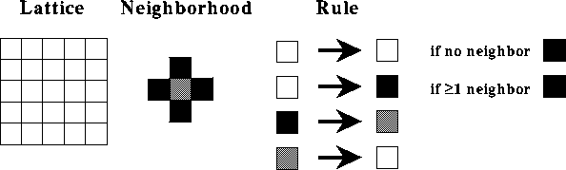
Cellular Automata
Can be extended to 3D lattice

Slide 18
“Game of Life”
A form of cellular automaton that takes an initial state of ‘live’ cells and performs the following each ‘generation’:
Any live cell with fewer than two live neighbors dies, as if by underpopulation.
Any live cell with two or three live neighbors lives on to the next generation.
Any live cell with more than three live neighbors dies, as if by overpopulation.
Any dead cell with exactly three live neighbors becomes a live cell, as if by reproduction.
Kieff, CC BY-SA 3.0

Slide 19
Dynamic Cellular Automata
A novel method to apply Brownian motion to objects in the Cellular Automata lattice (mimics collisions)
Takes advantage of the scale-free nature of Brownian motion and the scale-free nature of heterogeneous mixtures to allow simulations to span many orders of time (nanosec to hours) and space (nanometers to meters)

Slide 20
SimCell
Java application that uses Dynamic Cellular Automata (DCA) to model motions, interactions, transport and transformations at the meso-scale (10⁻⁸ to 10⁻⁶ m)
Uses a square, 2D lattice to model processes, lattice squares are equivalent to 3x3 nm regions
Molecular objects are moved randomly and interactions determined according to a set of interaction rules that are only applied when objects are in contact (collision detection)

Slide 21
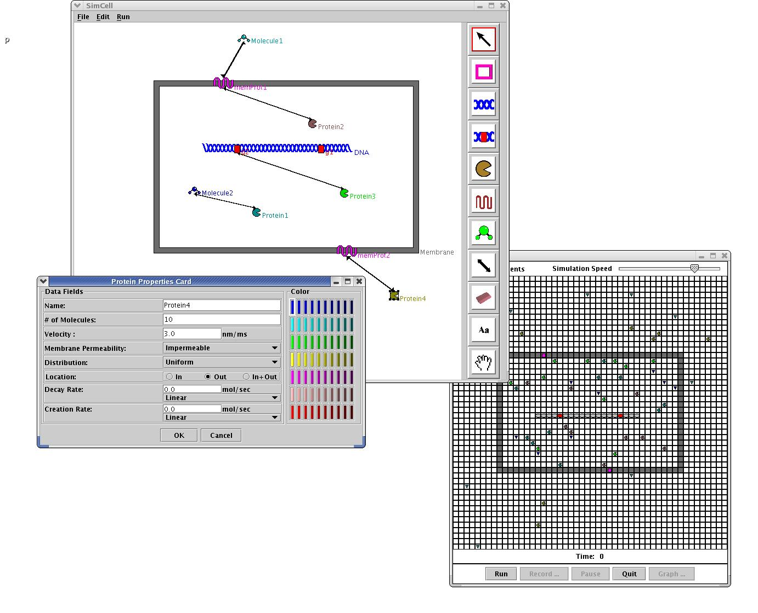
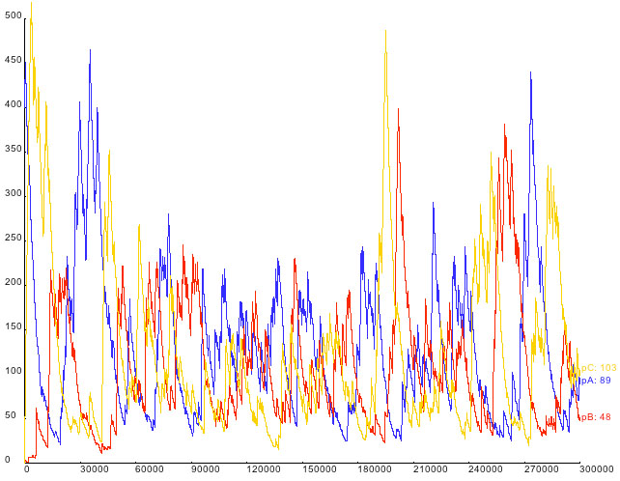
SimCell

